Slide 1
Murach’s SQL Server 2022
Chapter 2
How to use
Management Studio

Slide 2
Objectives
Applied
Use Management Studio to do the following management tasks:
Start or stop an instance of SQL Server Express
Enable a remote connection to a database
Navigate through the objects of a database
Create database diagrams for a database
View the column definitions for a table in a database
View or modify the data of a table in a database
Modify the column definitions for a table in a database
Use Management Studio to run, open, and save SQL queries.
Use the SQL Server documentation to look up information about SQL Server.

Slide 3
Objectives (cont.)
Knowledge
Briefly describe the function of each of these client tools: Management Studio, SQL Server Configuration Manager, Azure Data Studio.
Distinguish between Windows authentication and SQL Server authentication for connecting to a SQL Server database.

Slide 4
SQL Server 2022 tools
SQL Server Configuration Manager
SQL Server Management Studio
Azure Data Studio

Slide 5
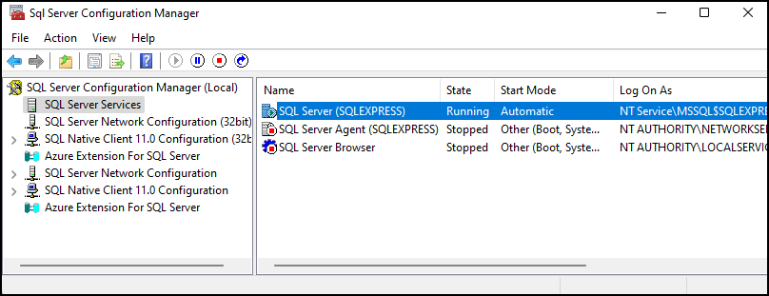
The SQL Server Configuration Manager (Services)
Murach’s SQL Server 2022

Slide 6
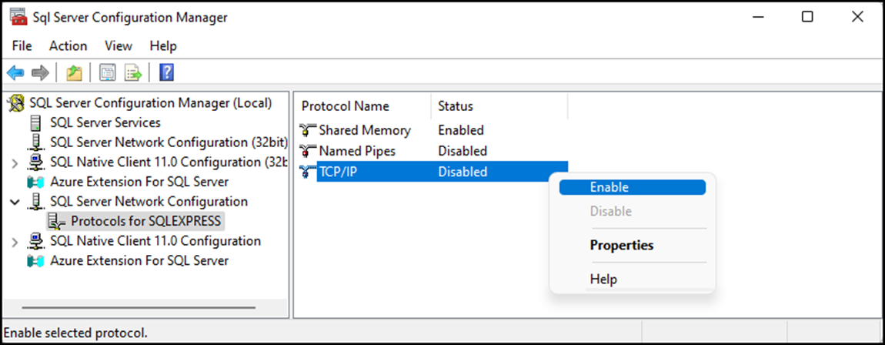
The SQL Server Configuration Manager (Network)
Murach’s SQL Server 2022

Slide 7
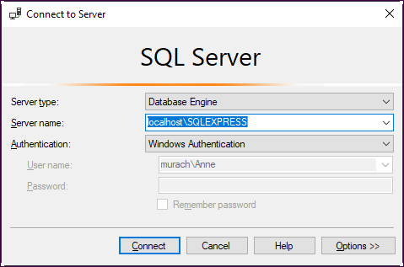
How to connect using Windows authentication
Murach’s SQL Server 2022

Slide 8
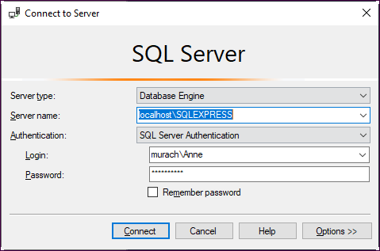
How to connect using SQL Server authentication
Murach’s SQL Server 2022

Slide 9
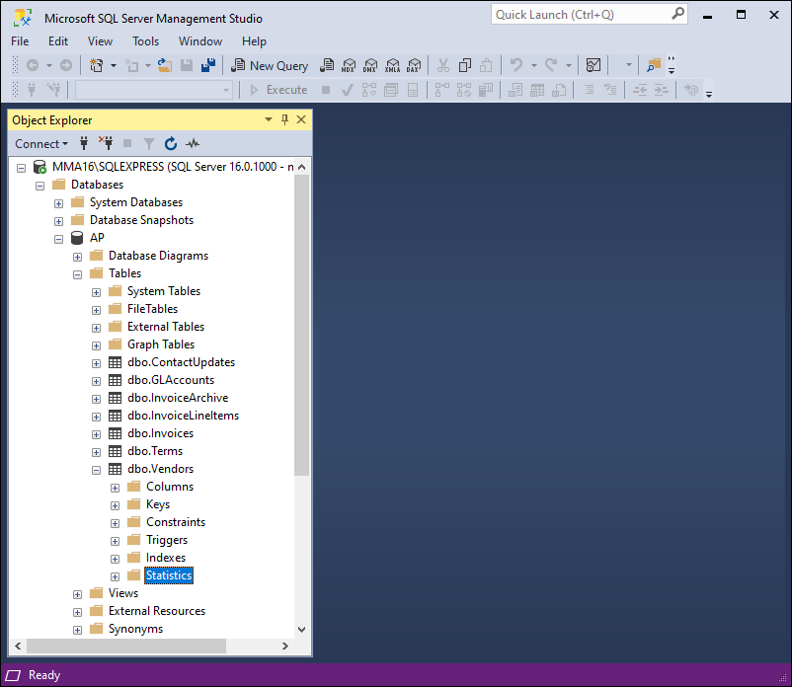
Management Studio and the Object Explorer
Murach’s SQL Server 2022

Slide 10
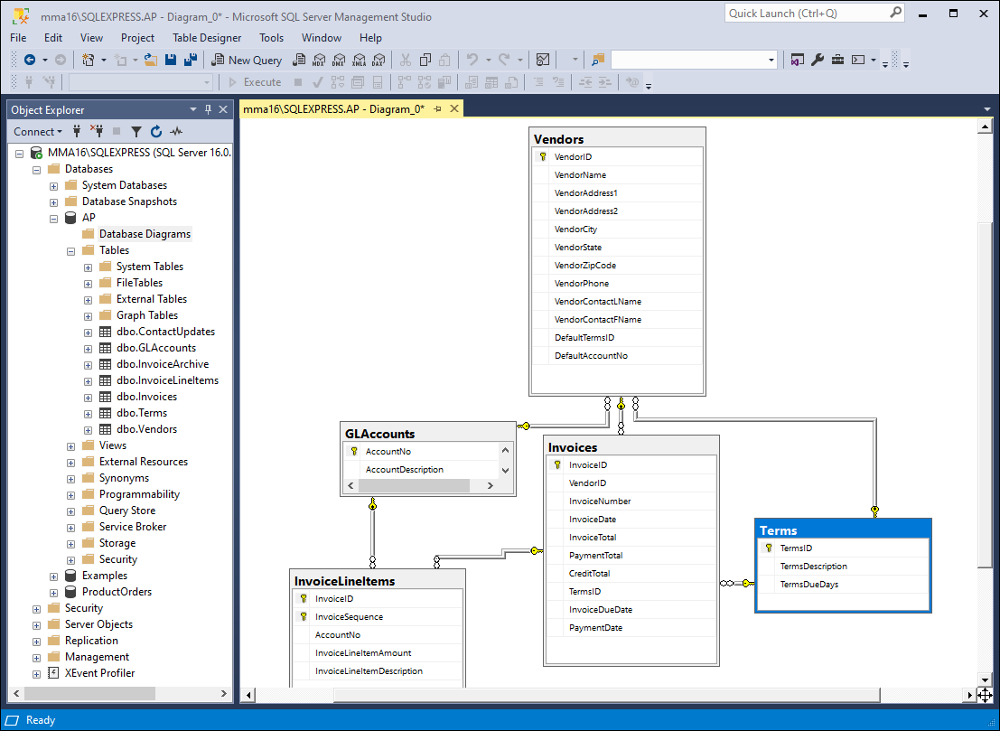
The relationships in the AP database
Murach’s SQL Server 2022

Slide 11
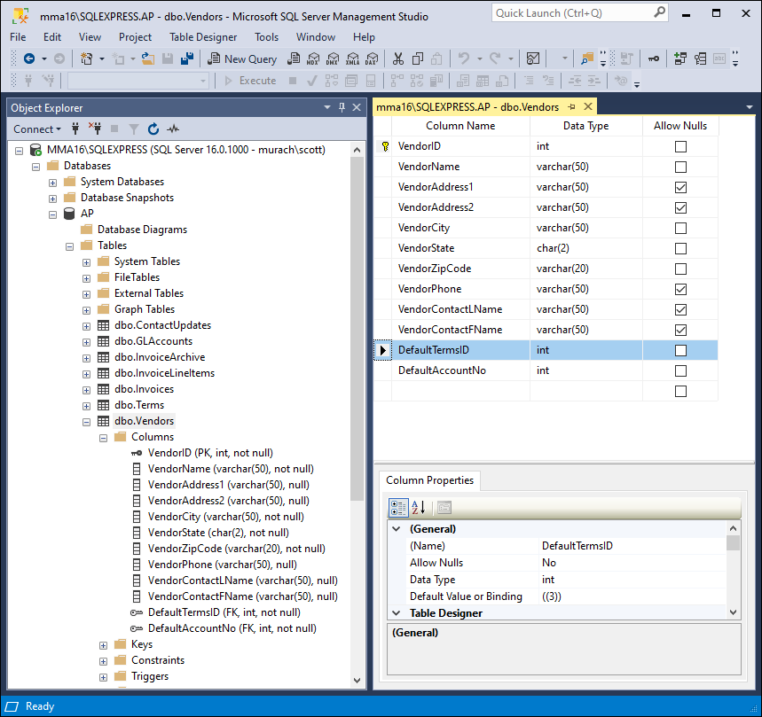
The columns in the Vendors table
Murach’s SQL Server 2022

Slide 12
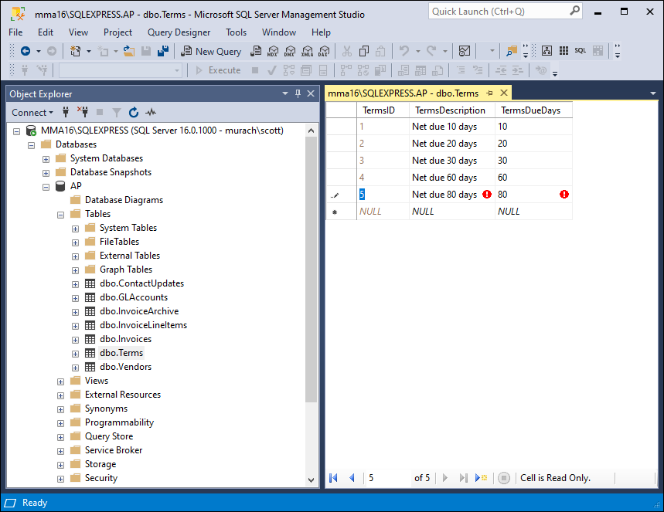
A row as it’s being modified
Murach’s SQL Server 2022

Slide 13
How to view or modify the data of a table
To view the data for a table, expand the Tables node, right-click on the table, and click Select Top 1000 Rows.
To modify the data for a table, expand the Tables node, right-click on the table, and click Edit Top 200 Rows to display the rows in a grid. Then, you can use the grid to insert, update, and delete data from the table.
To commit the changes you’ve made to a row, move the cursor to another row.
To abandon the changes you’ve made to a row, press the Esc key. This is known as rolling back changes.

Slide 14
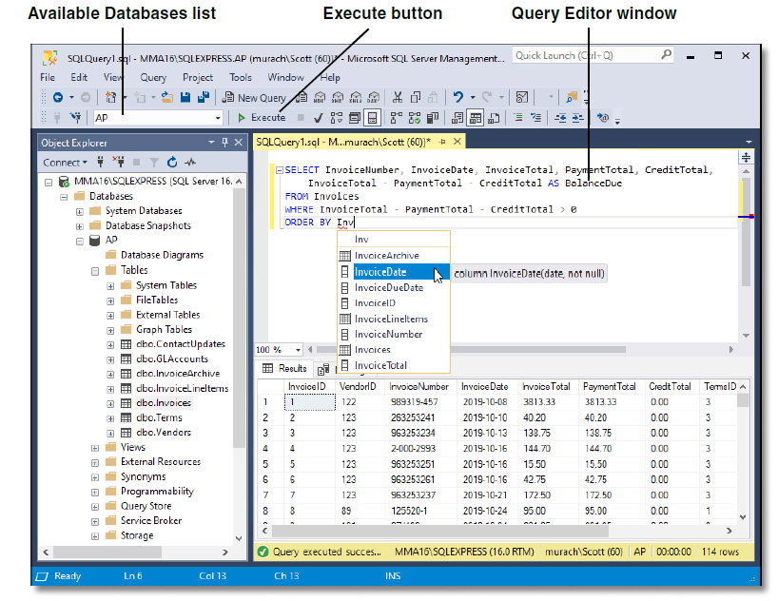
A SELECT statement with a completion list
Murach’s SQL Server 2022

Slide 15
How to enter and execute a query
To open a new Query Editor window, click on the New Query button in the toolbar.
To select the database that you want to work with, use the Available Databases list in the toolbar.
To enter a SQL statement, type it into the Query Editor window.
As you enter a SQL statement, the IntelliSense feature automatically displays completion lists that help you complete the statement.
To select an item from a completion list, use the Up or Down arrow key to select the item and press the Tab key. To hide a list, press the Esc key.
To execute a SQL statement, press the F5 key or click the Execute button in the toolbar.

Slide 16
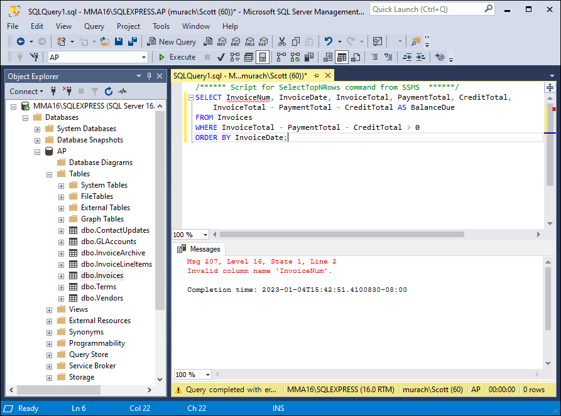
Management Studio with an error message
Murach’s SQL Server 2022

Slide 17
Common causes of errors
Forgetting to select the correct database from the Available Databases list
Misspelling the name of a table or column
Misspelling a keyword
Omitting the closing quotation mark of a character string

Slide 18
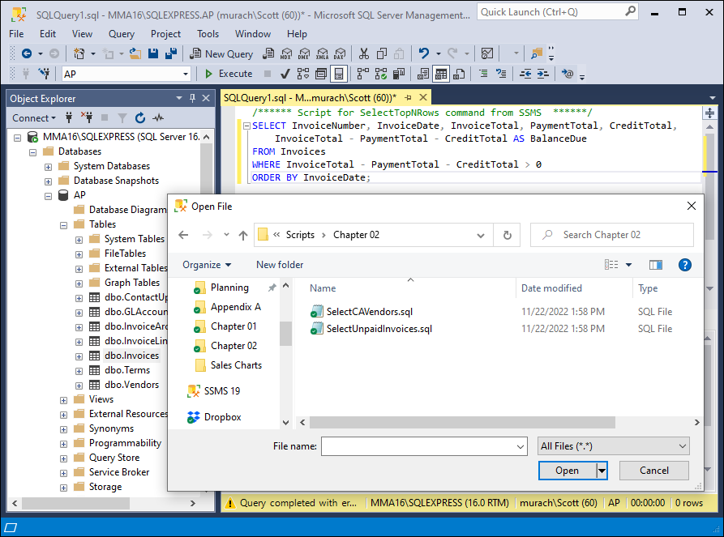
The Open File dialog box
Murach’s SQL Server 2022

Slide 19
How to open and save queries
To save a query, click the Save button in the toolbar or press Ctrl+S, and then enter a file name if necessary.
To open a query, click the Open button in the toolbar or press Ctrl+O. Then, use the Open File dialog box to locate and open the query.
To save all open queries, click the Save All button in the toolbar, and then specify a file name for any queries that haven’t already been named.

Slide 20
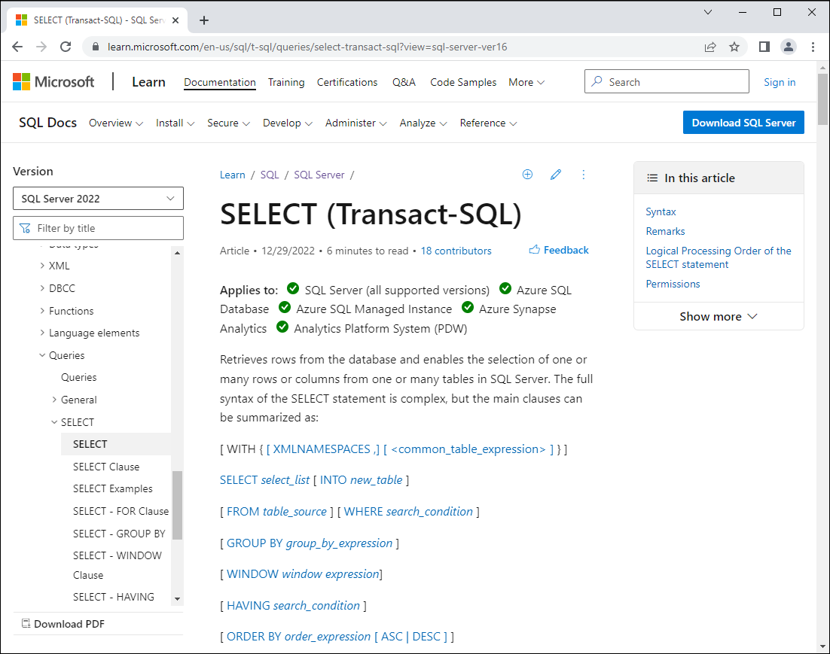
The documentation for the SELECT statement
Murach’s SQL Server 2022

